Slide 1

Dr. LeCharle Harris
Assistant Principal (3rd-5th Grade)

Slide 2

Black History Month
Serena Williams

Slide 3
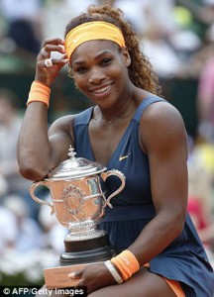
Serena
Williams

Slide 4
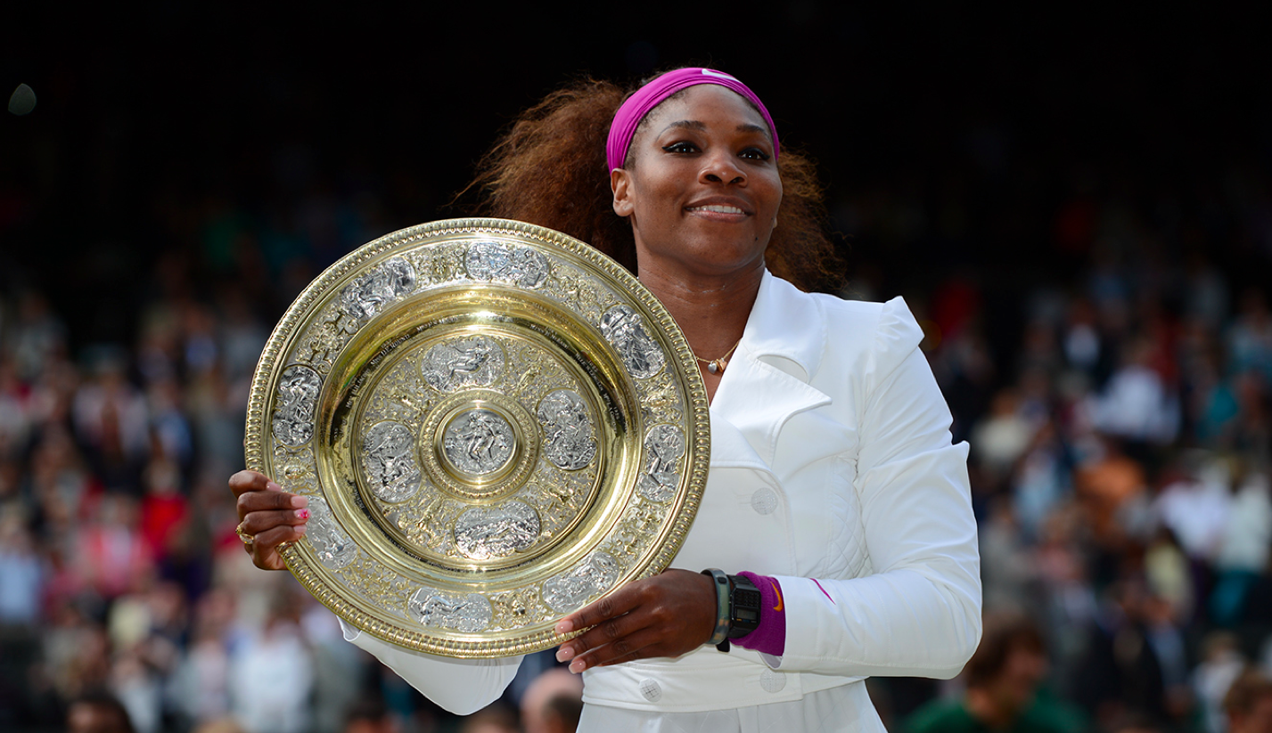
Serena Williams, (born September 26, 1981, Saginaw, Michigan, U.S.), American tennis player who revolutionized women’s tennis with her powerful style of play and who won more Grand Slam singles titles (23) than any other woman or man during the open era.

Slide 5
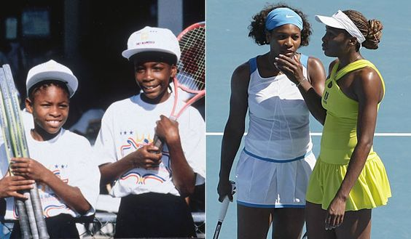
Williams learned tennis from her father on the public courts in Los Angeles and turned professional in 1995, one year after her sister Venus. Many predicted Venus would be the first Williams sister to win a Grand Slam singles title, but it was Serena who accomplished the feat, winning the 1999 U.S. Open. At that tournament the sisters won the doubles event, and, over the course of their careers, the two teamed up for 14 Grand Slam doubles titles.

Slide 6
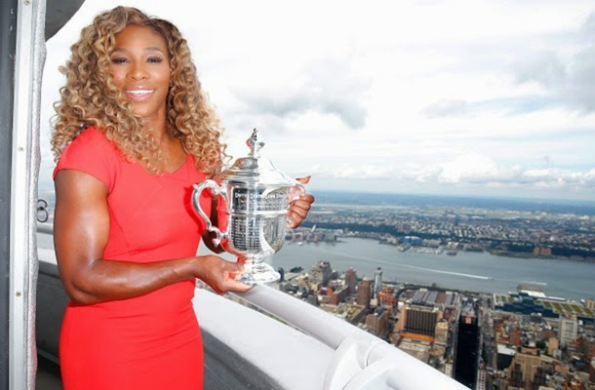
After several years of inconsistent play, Serena asserted herself in 2002 and won the French Open, the U.S. Open, and Wimbledon, defeating Venus in the finals of each tournament. Known for her fierce tenacity, Serena won the Australian Open in 2003 and thus completed a career Grand Slam by having won all four of the slam’s component tournaments. She continued her torrid streak at Wimbledon, winning a straight-set final to capture her sixth career Wimbledon singles title. Williams again won Wimbledon in 2016, giving her 22 career Grand Slam singles titles, which tied her with Graf for the most Slams in the open era for both women and men. Williams broke Graf’s record at the 2017 Australian Open, where she defeated her sister Venus in the final.

Slide 7
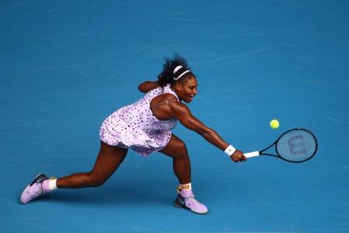

Williams’s autobiography, On the Line (written with Daniel Paisner), was published in 2009.

Slide 8
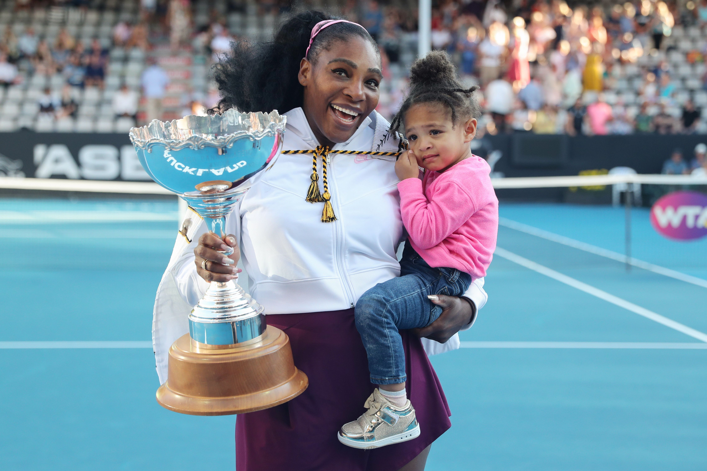
In April 2017, Williams announced that she was pregnant (she had gotten engaged to Alexis Ohanian, cofounder of the Web site Reddit, in December 2016) and would miss the remainder of the 2017 season. In September she gave birth to a daughter, and two months later she married Ohanian. Williams returned to tennis in March 2018.

Slide 9
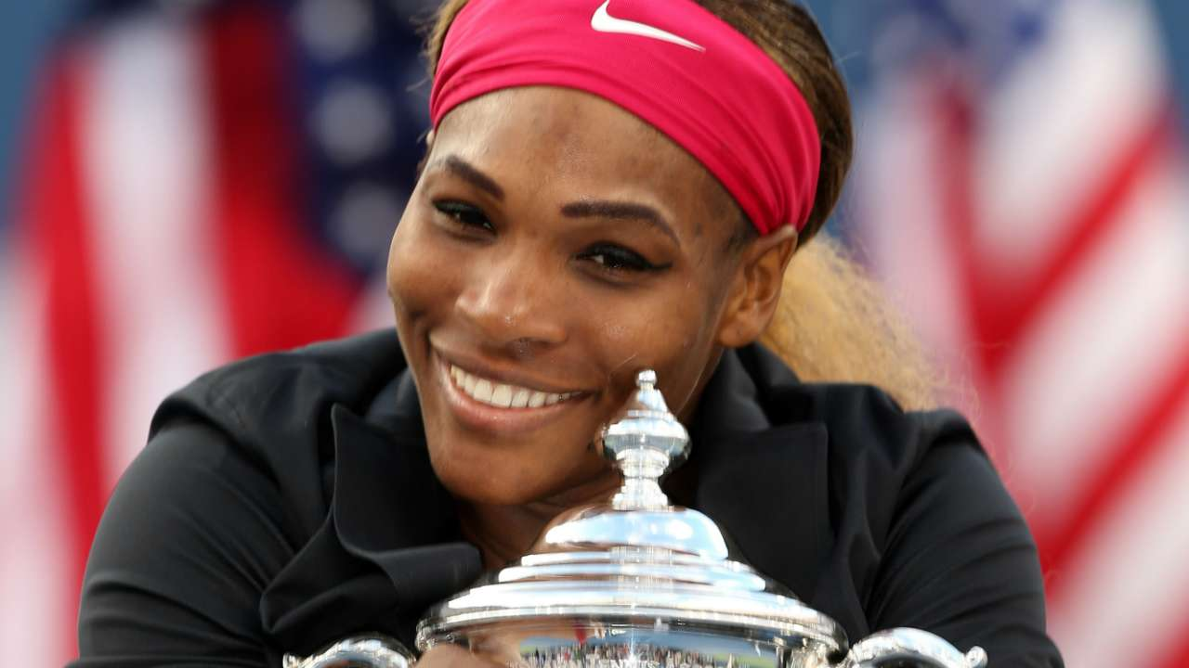
"Growing up I wasn’t the richest, but I had a rich family in spirit.
Standing here with 19 championships is something I never thought would happen. I went on a court just with a ball and a racket and with a hope."

